Slide 1
Capstone Mahindra First Choice Data Analysis
Created by -
Saurabh Dhawale
Mohd aamir

Slide 2
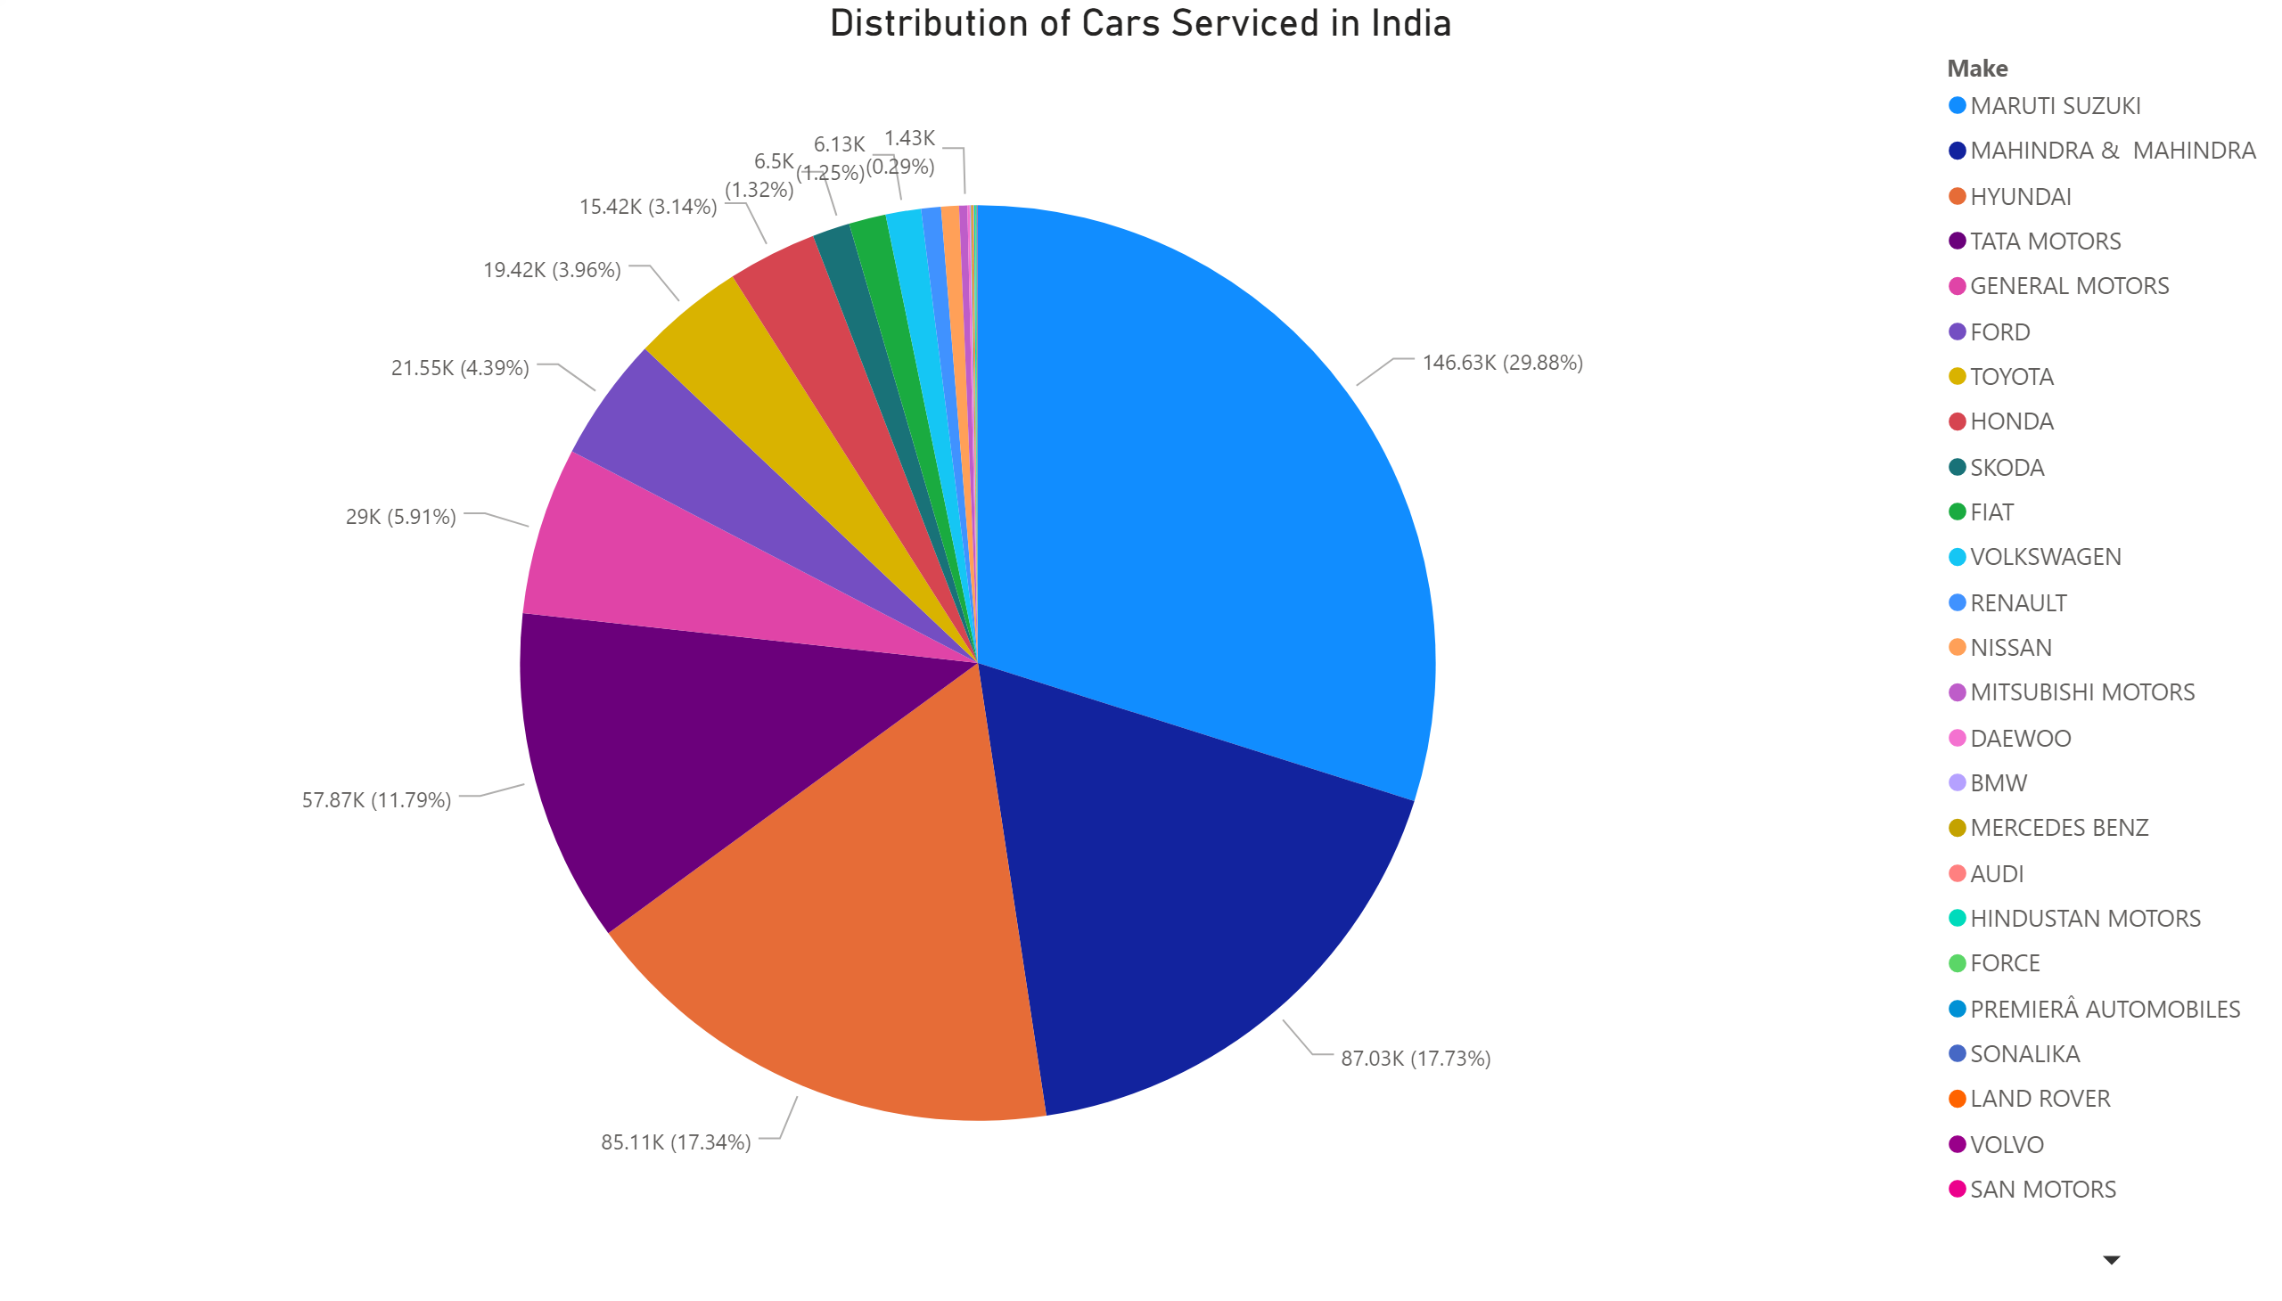

Slide 3
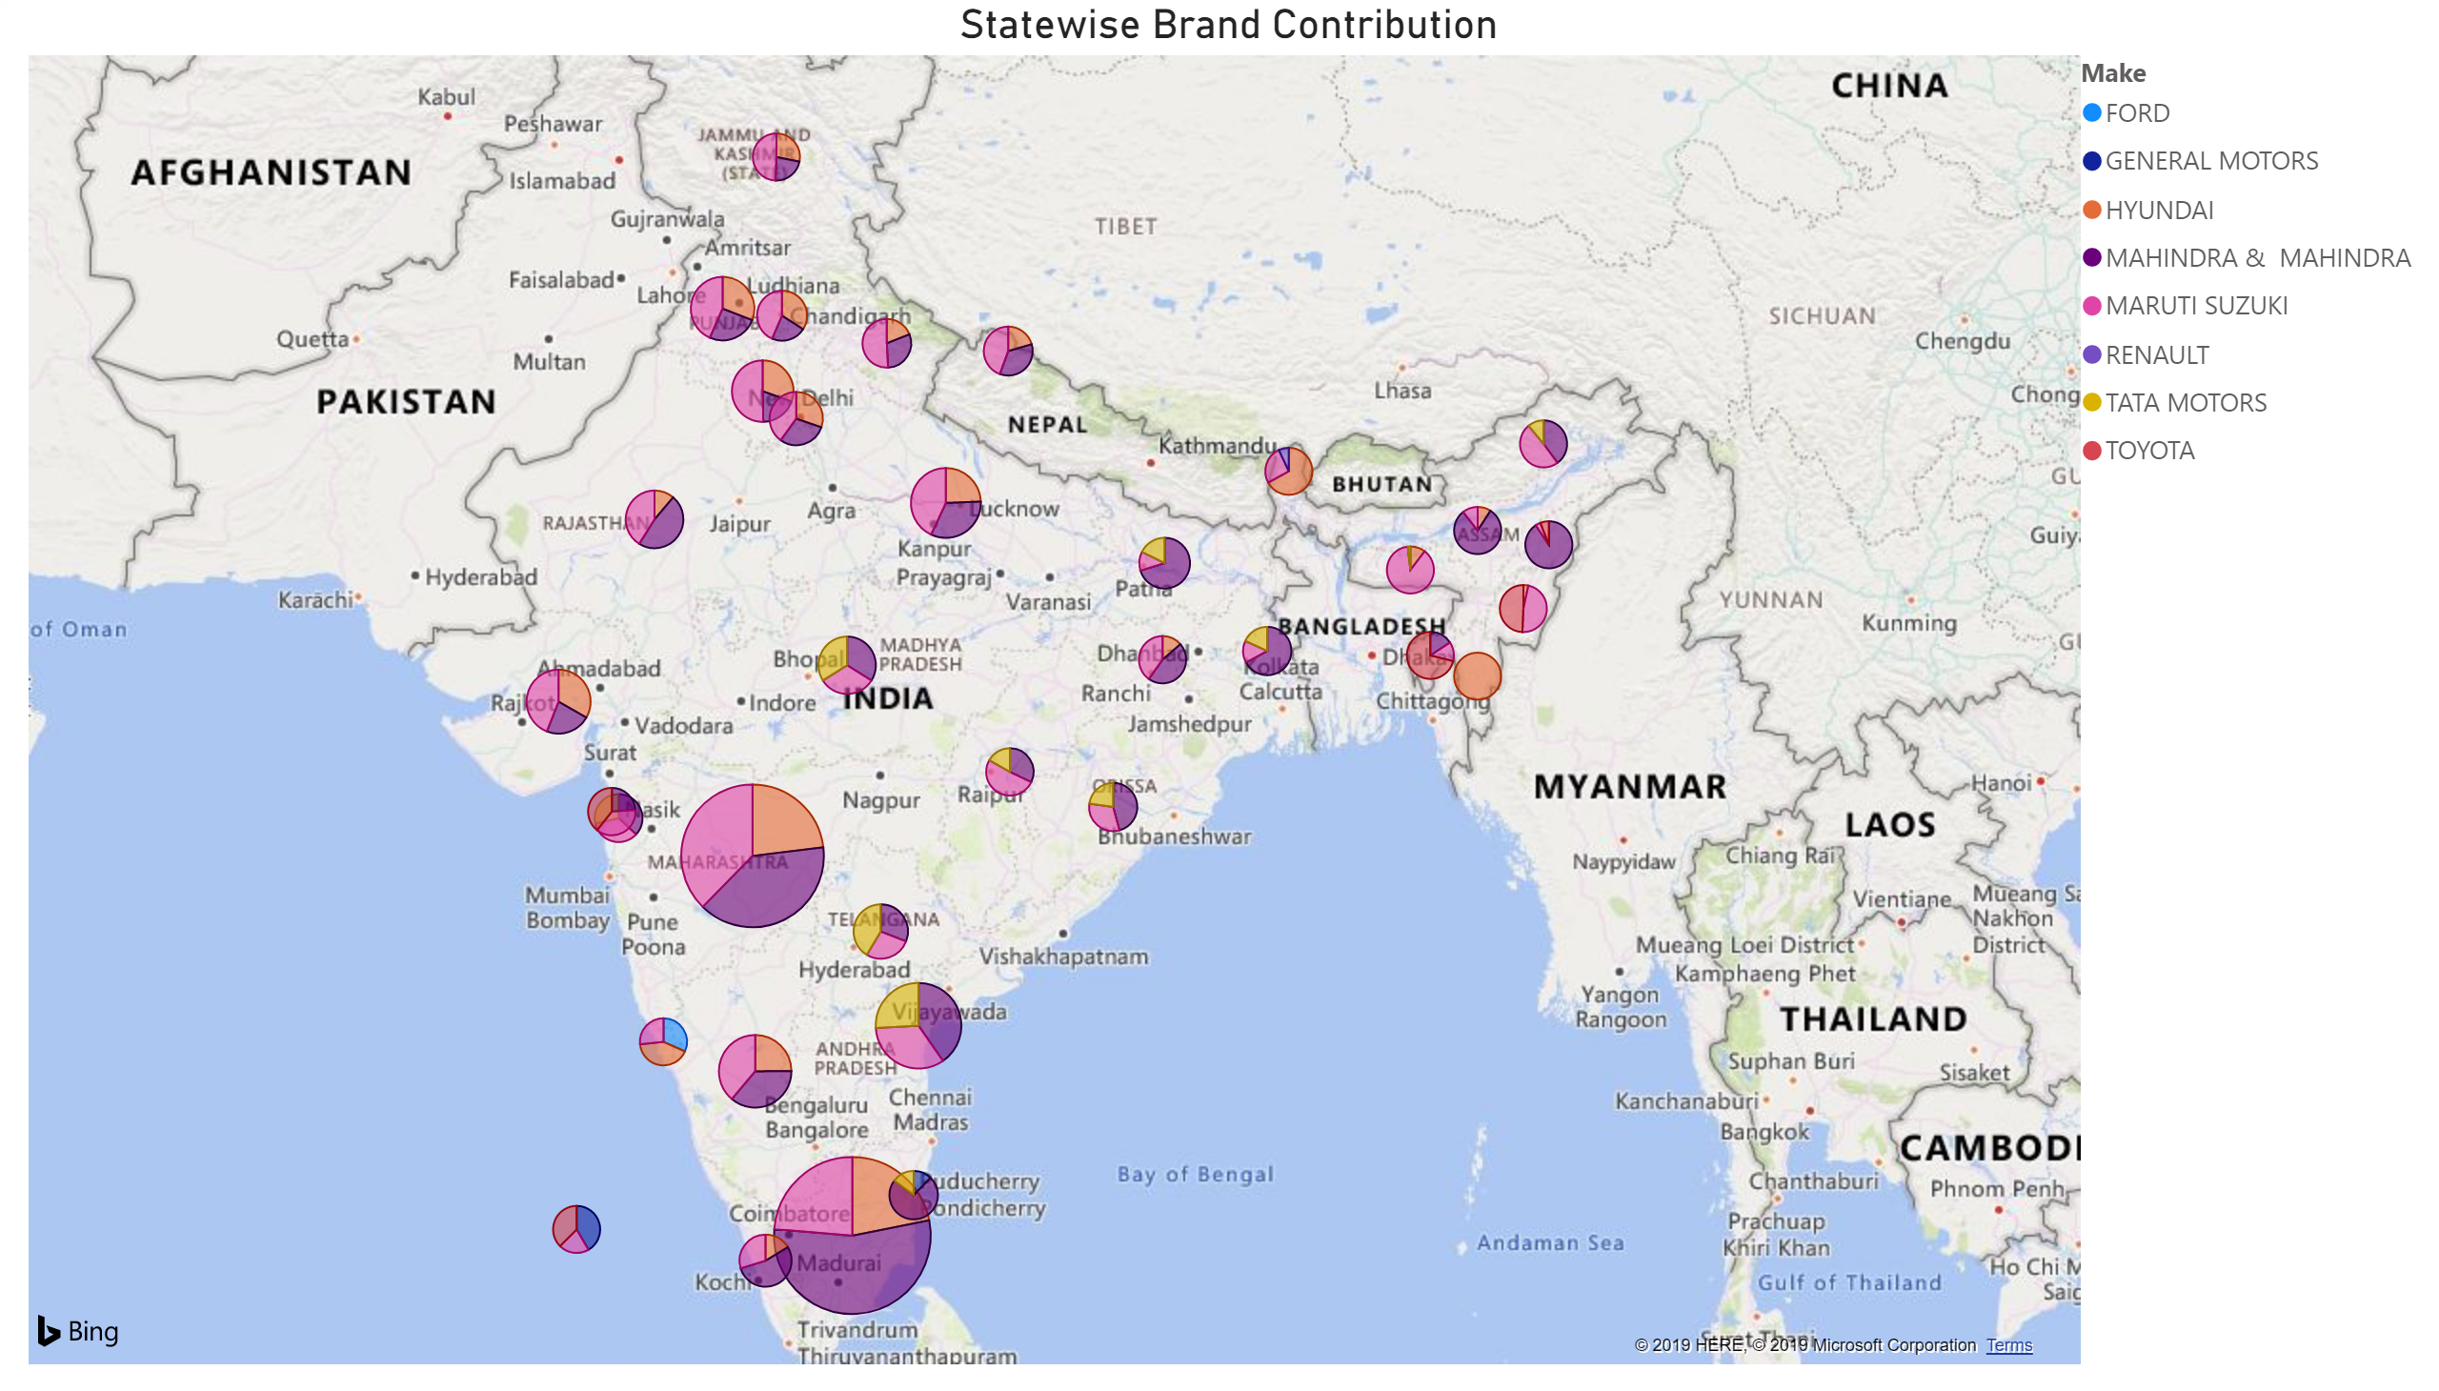

Slide 4
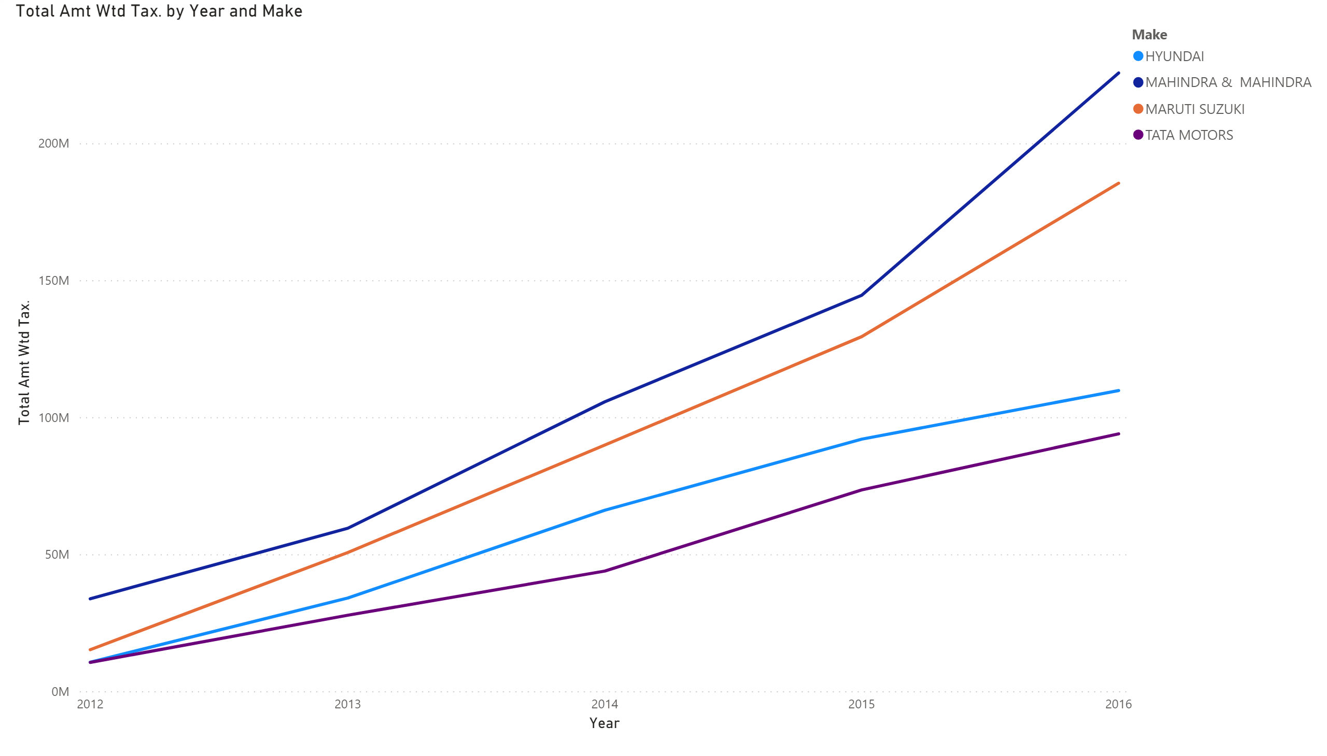

Slide 5
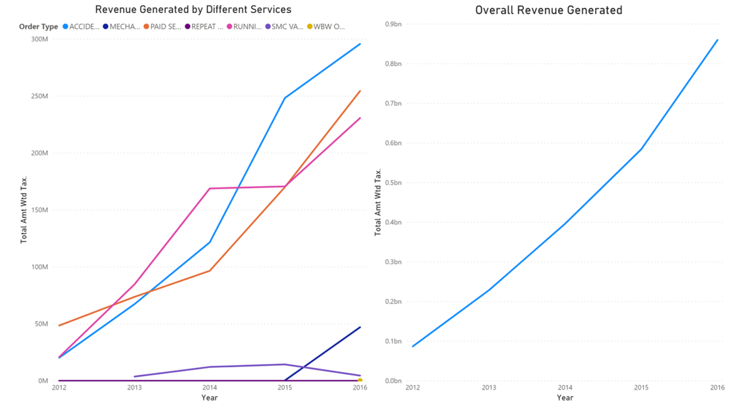

Slide 6
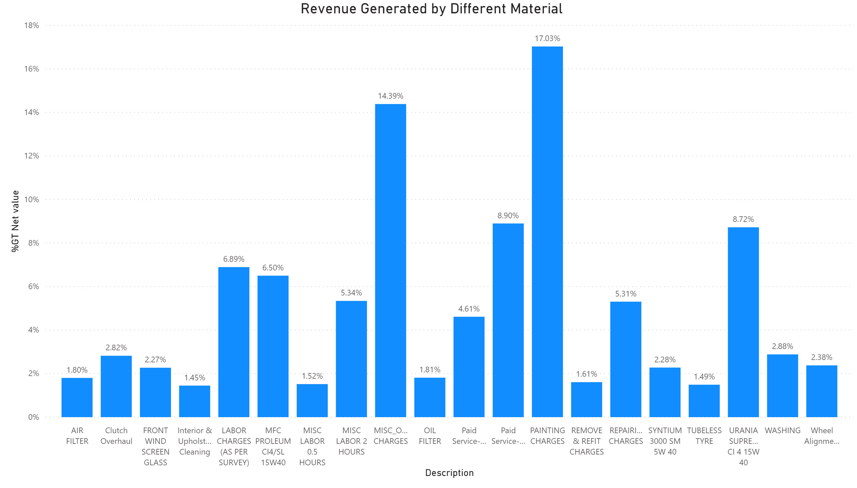

Slide 7
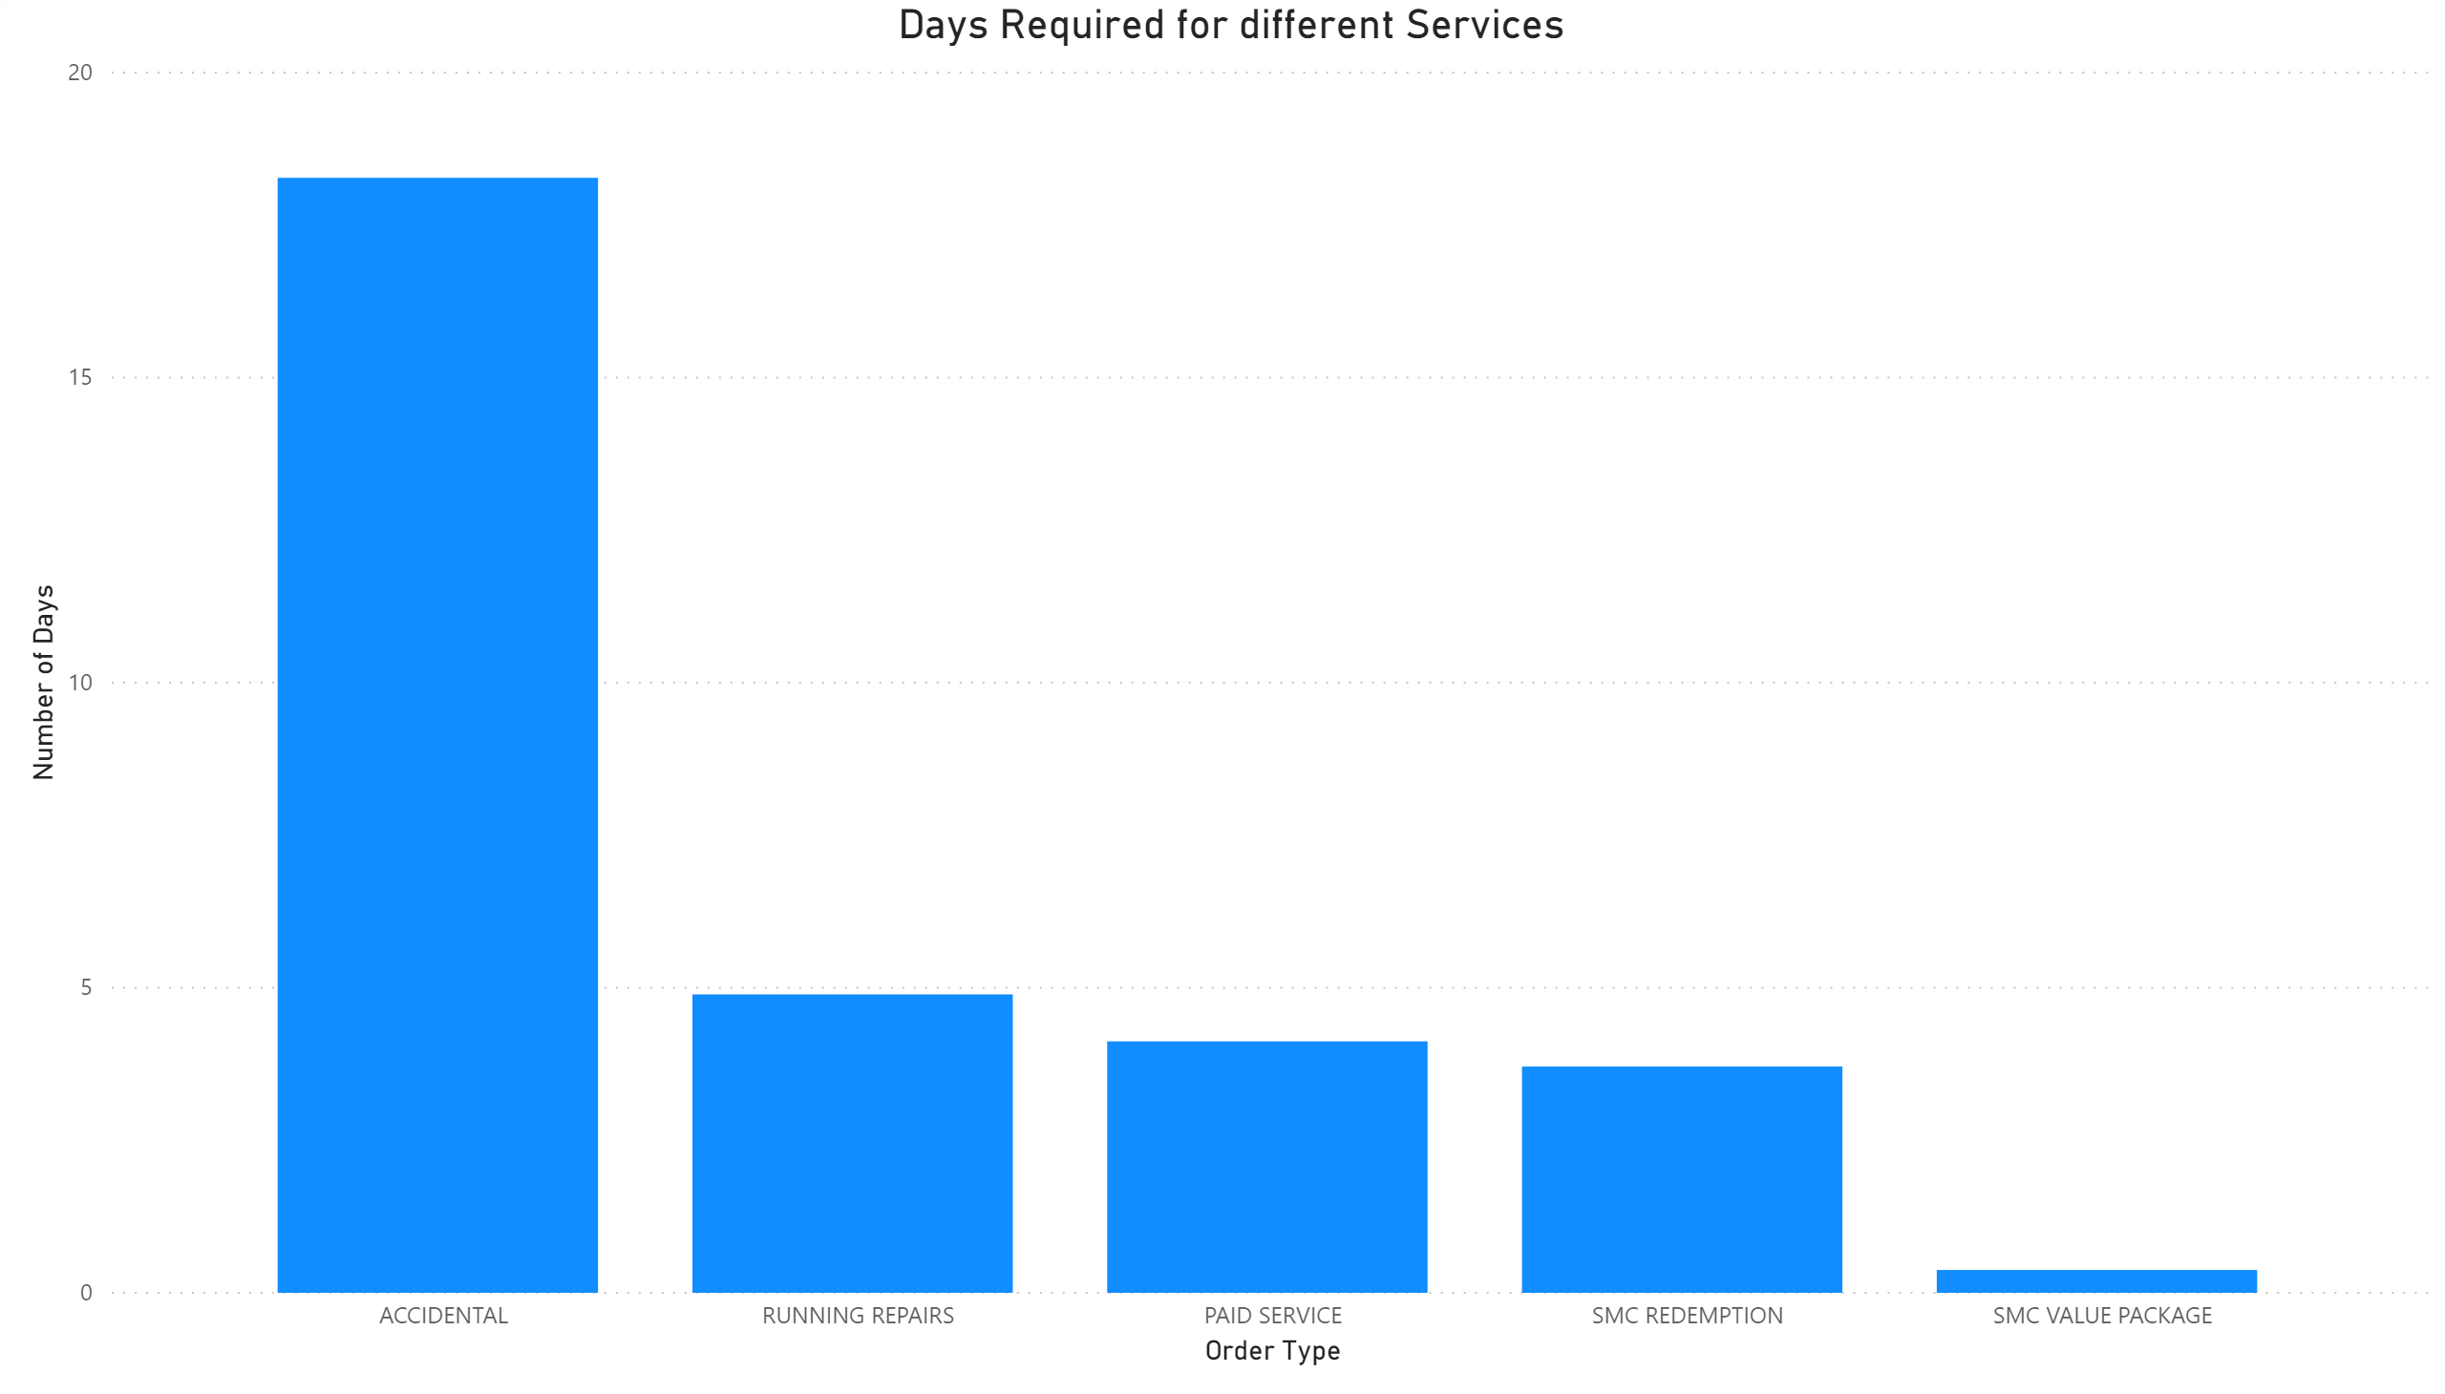

Slide 8
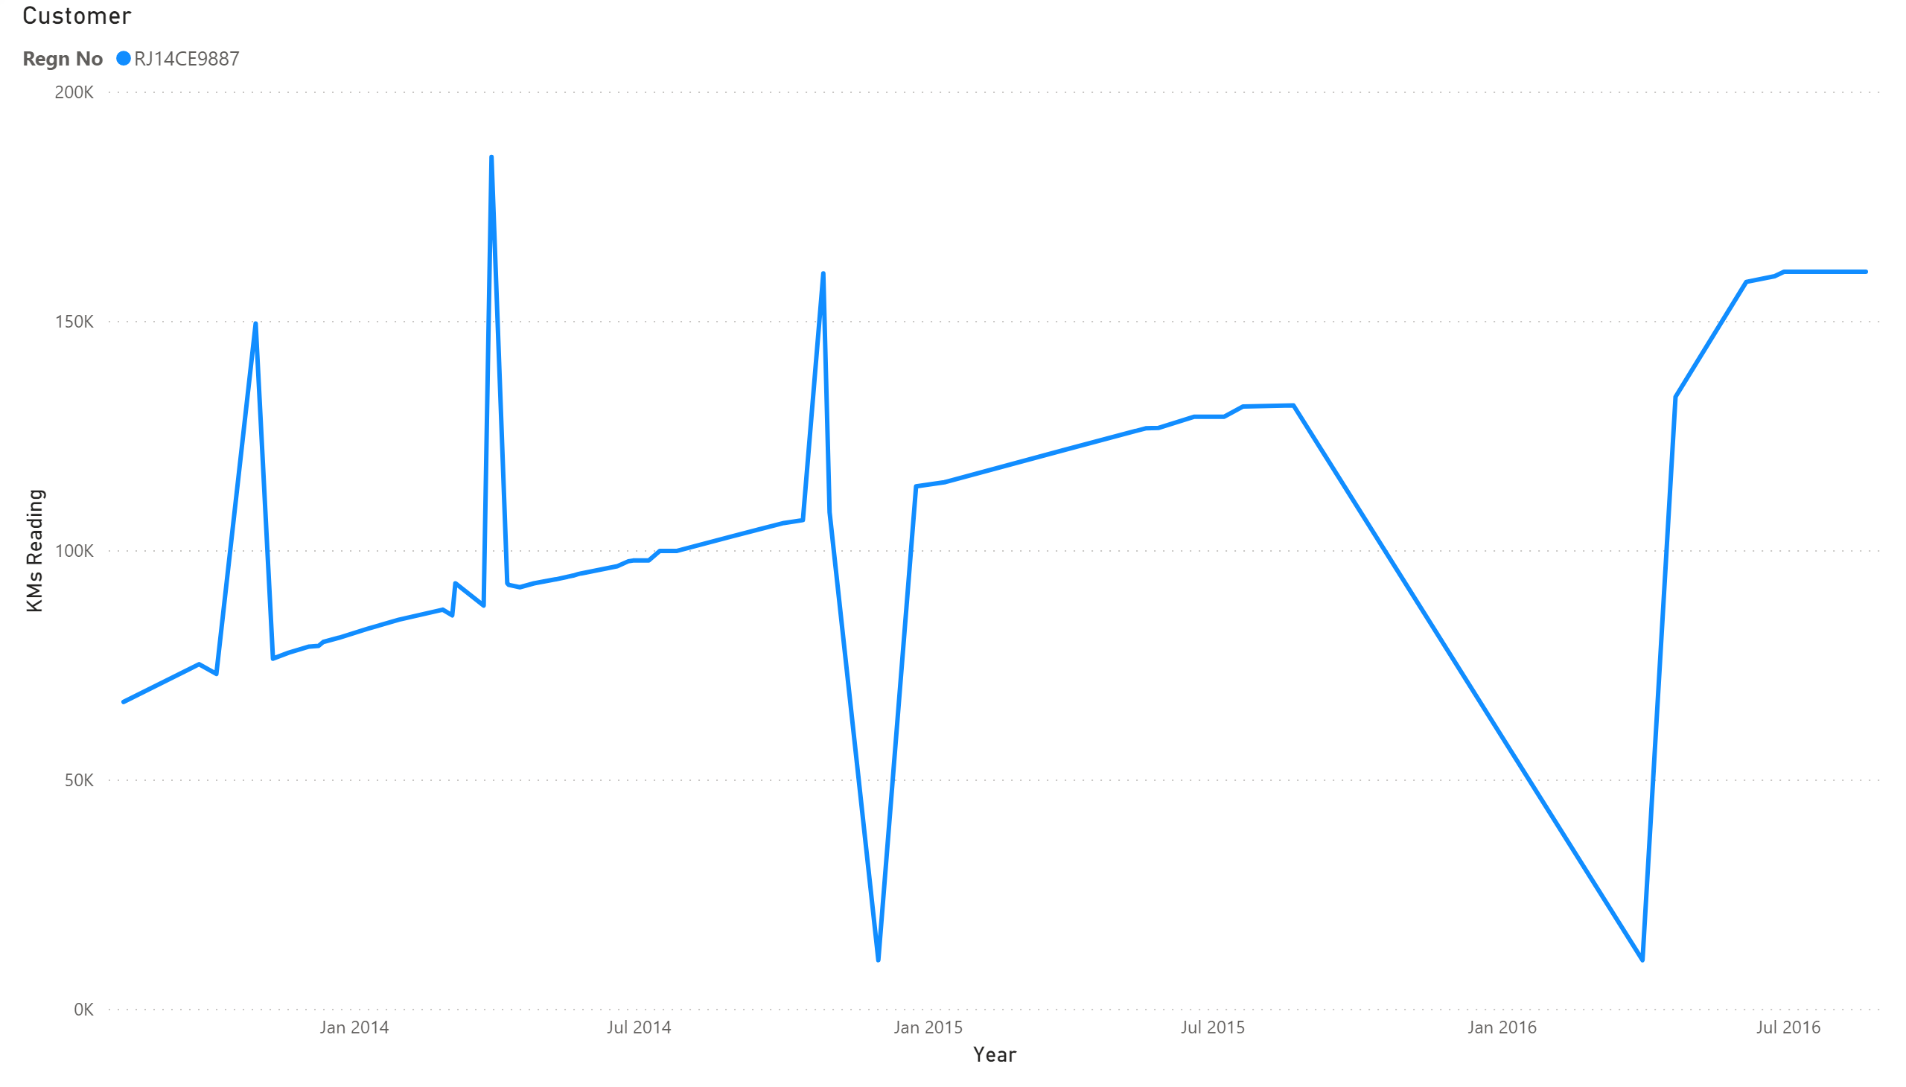

Slide 9
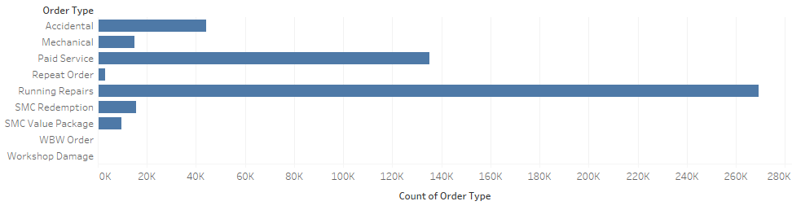
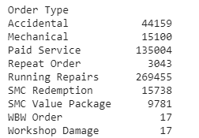
What are the different types of services provided?
Maximum Services used by customers are
Accidental, Paid Service & Running repairs.

Slide 10
What is the difference in each service/labour costing?
It depends on following factors:
Car Model (Make) : type of vehicle, size of vehicle & petrol type
Locality : The basic labor charge varies based on the location as the land cost varies.
3) Service type: cleaning, general checkup, Car washing,
Engine Scanning through software, Alignment, Tyre rotation all covered.

Slide 11
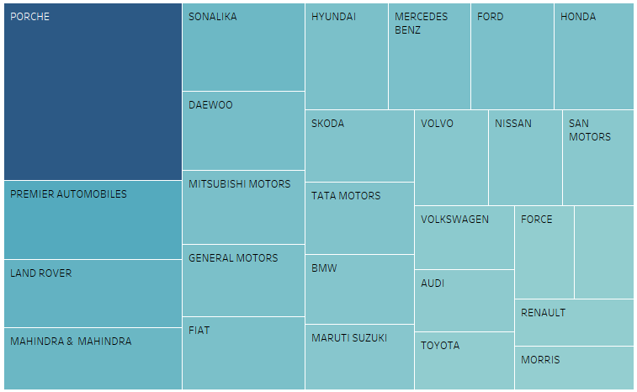
Labour Costing for the factor Make
Make
PORCHE
1983.685
PREMIER AUTOMOBILES 879.070
LAND ROVER
761.700
MAHINDRA & MAHINDRA 694.885
SONALIKA
674.740

Slide 12
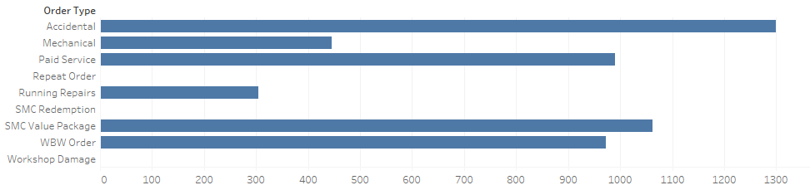
Labour costing for the factor service type
Order Type
Accidental 1300.070
Mechanical 445.035
Paid Service 989.990
Repeat Order 0.000
Running Repairs 304.400
SMC Redemption 0.000
SMC Value Package 1062.060
WBW Order 972.060
Workshop Damage 0.000

Slide 13
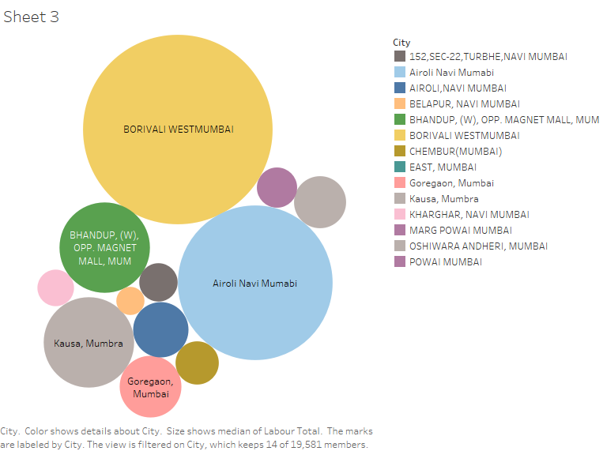
Labour costing for the factor Locality (areas in Mumbai)

Slide 14
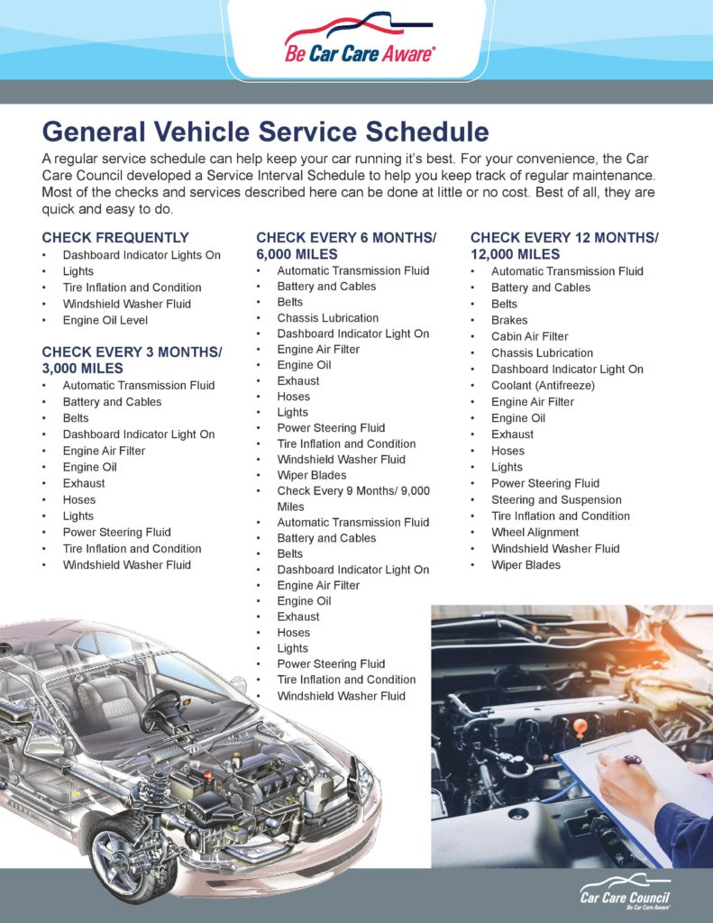
Is the service seasonal or regular?

Slide 15
Seasonal
1. Winter :
oil leaks,
shock absorber leakage,
exhaust system mountings leakage,
Brake and fuel lines for leakage etc.
oil level
coolant level
radiator fan operation
steering fluid
clutch and accelerator free play
fuses and relays
2. Monsoon :
Brake fluid lines
Tire conditions
Wiper arms
Power window operations
Central locking operation
3. Summer :
Coolant System
Engine Belts
Air-Conditioning System
Air Filters
Dashboard Sunshade
Yes ! Services are Mandatory

Slide 16
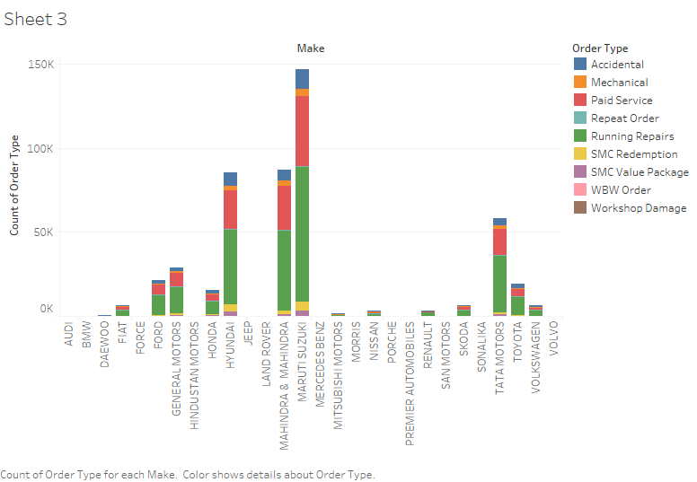
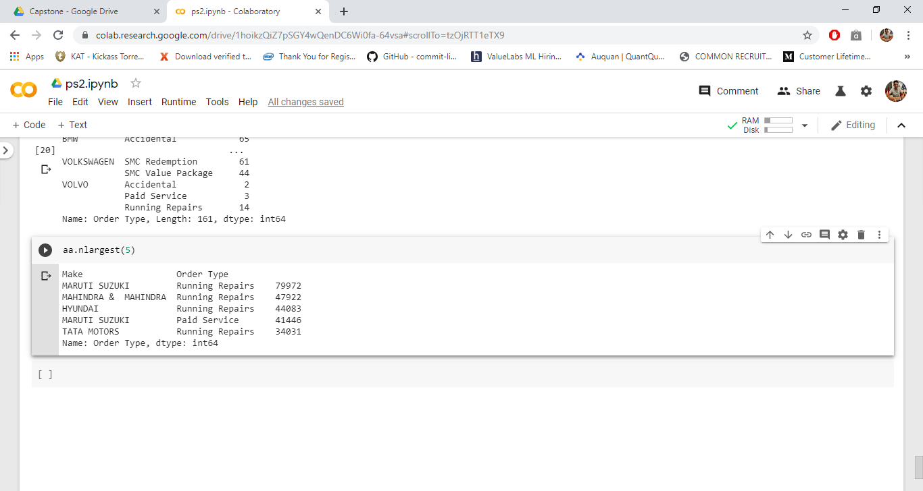
Which service is popular regarding a certain make/car?

Slide 17
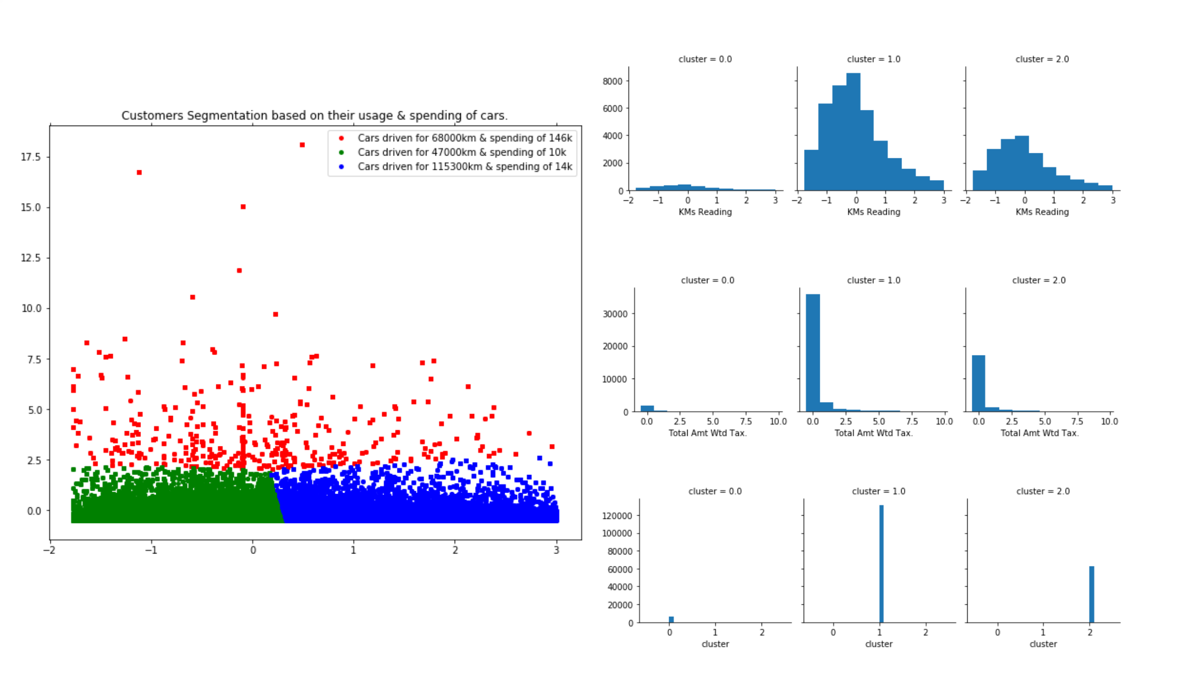

Slide 18
To tackle various seasonal cases
For all the seasonal cases we will offer discounts on mechanical, paid services & WBW order.
According to visit of customers, we will offer them discount coupons on upcoming seasonal cases.
Our focus will be Long weekend holidays.
Based on Km Readings we will target the customers.

Slide 19
Enhancements:
Dig deep in Map check what makes top 3 brands in different states ex: Types of services used, Distribution of Make
Make better line charts for revenue (drill option)
Max parts used for service,in paint mandatory or we can come with can come up with some different product
Cost margin analysis for labour charges to come up with some schemes.
Overall Dig Deep and drill down

